Slide 1
Overconsumption:The action or fact of consuming something to excess
Professor Rebecca Bratspies

Slide 4
Emissions are Not Equal Across Countries!

Slide 5
Over Time, the Inequalities Are Even More Stark

Slide 7
Ecological Debt Day (Earth Overshoot Day)
The date our resource consumption for the year exceeds the Earth’s capacity to regenerate those resources
In 2015, Ecological Debt Day was August 13.
In 1970, Ecological Debt Day was December 23.

Slide 8
Some Factoids about the United States
Americans represent 5% of the world’s population, but consume 20% of the world’s energy and generate 40% of the world’s garbage.
An average middle-class American family consumes 4 million pounds of material every year!

Slide 9
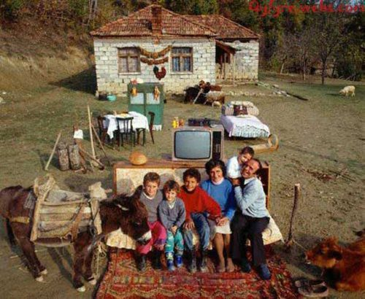
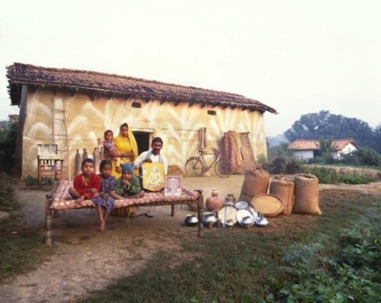
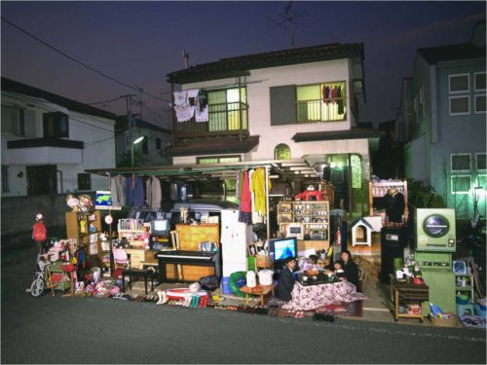
People and their Stuff

Slide 11
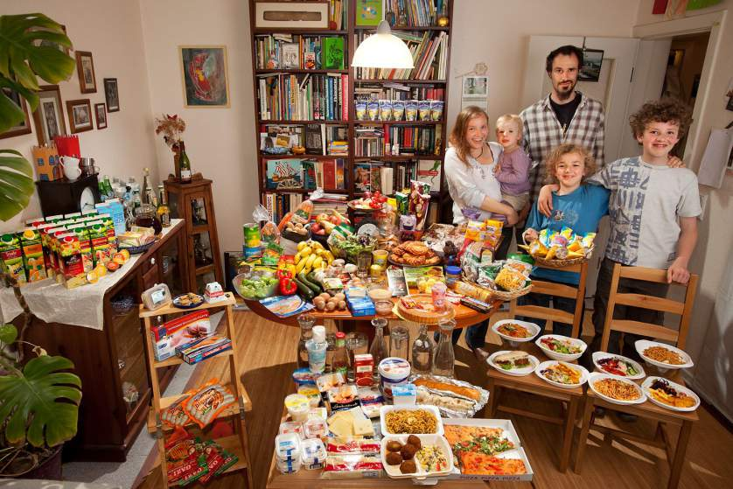
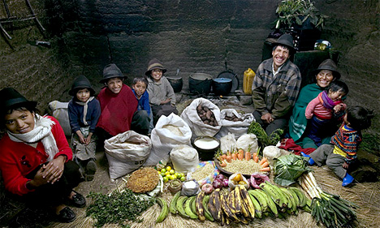
What the World Eats

Slide 12
If food were a country . . .
It would have the 3rd highest greenhouse gas emissions after the United States and China

Slide 13
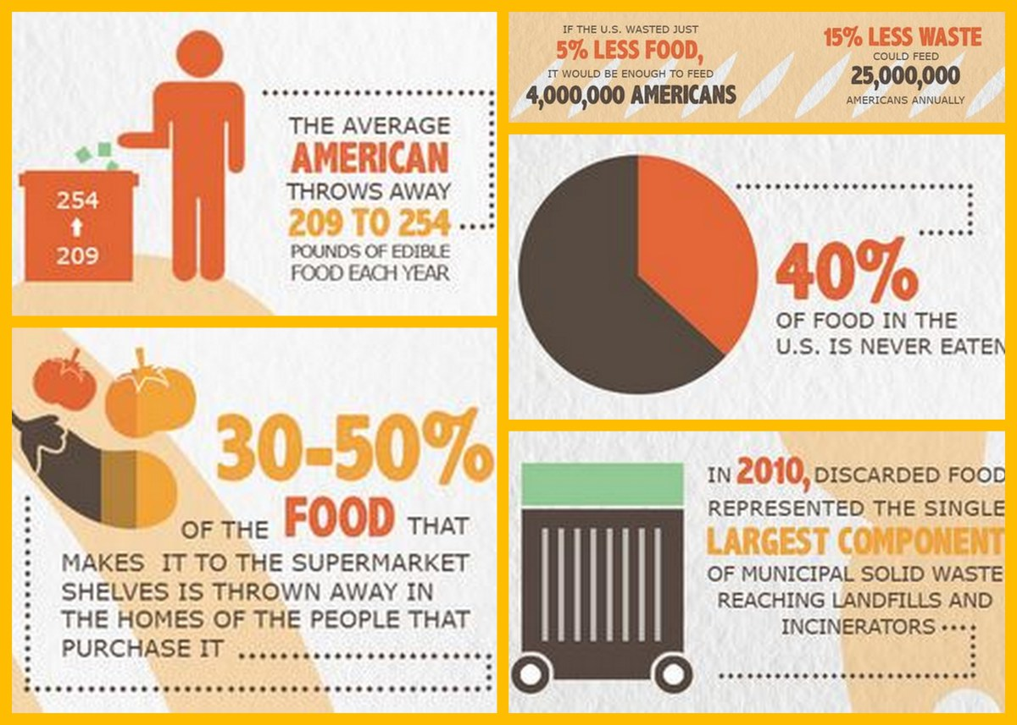

Slide 14
New Yorkers throw away 7 tons of food a day-over 2500 tons each year

Slide 15
Ajay K Jha
Ajay K Jha

Slide 16
How Many Earths We Need . ..

Slide 17
Overconsumption:The action or fact of consuming something to excess

Slide 18
Thank you!

